Slide 1

Predicting device failure

Slide 2
CRISP-DM
1
Business Objective
2
Data Understanding
3
Data Preparation
4
Modeling
5

Slide 3

CRISP-DM
Overview
Business Understanding
Data Understanding
Data Preparation
Modeling
Evaluation
Deployment
© Copyright 2016 GBCS LLC

Slide 4
CRISP-DM
1
Business Objective
2
Data Understanding
3
Data Preparation
4
Modeling
5

Slide 5
2. Objective
Company has a fleet of devices transmitting daily aggregated telemetry attributes.
Predictive maintenance techniques are designed to help determine the condition of in-service equipment in order to predict when maintenance should be performed. This approach promises cost savings over routine or time-based preventive maintenance, because tasks are performed only when warranted.

Slide 6
Goal
You are tasked with building a predictive model using machine learning to predict the probability of a device failure. When building this model, be sure to minimize false positives and false negatives. The column you are trying to predict is called failure with binary value 0 for non-failure and 1 for failure.

Slide 7
CRISP-DM
1
Business Objective
2
Data Understanding
3
Data Preparation
4
Modeling
5

Slide 8
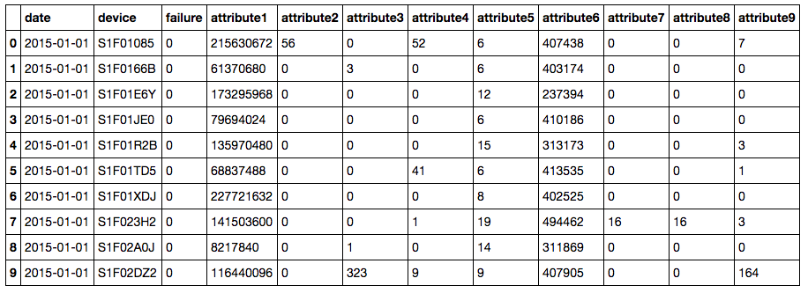
Data Understanding

Slide 9
CRISP-DM
1
Business Objective
2
Data Understanding
3
Data Preparation
4
Modeling
5

Slide 10
CRISP-DM
1
Business Objective
2
Data Understanding
3
Data Preparation
4
Modeling
5

Slide 11
Modeling
Build a model to predict device failure
© Copyright 2016 GBCS LLC

Slide 12
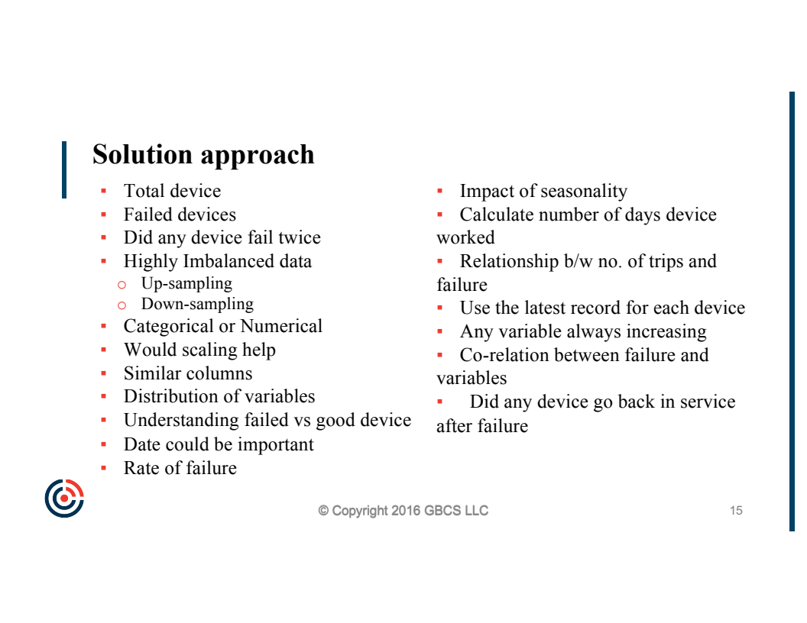

Slide 13
Modeling
Split data (train and test)
Data preperation
Algorithm selection
Learning
Predict
Evaluate your model
© Copyright 2016 GBCS LLC

